Slide 1

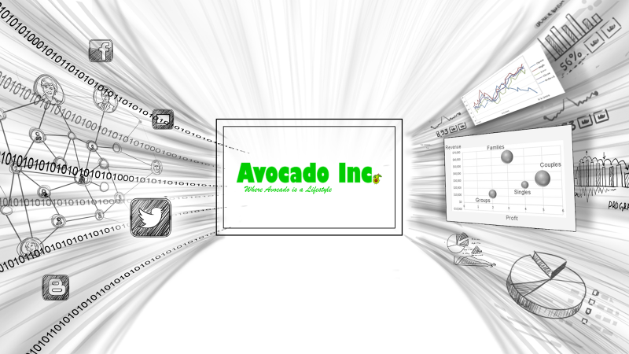
Avocado Inc. intends to unlock the power of data with minimal investment in any specialized resources such ad Data Scientists and Heavy Compute Power
Avocados Inc. wants to get better insights on the success of their marketing campaigns and also to make data-driven decisions for future marketing campaign investments. To do this Avocado Inc. needs to combine silos of data with real-time social media data and leveraging Big Data and Machine Learning.
Copyright © 2017 Oracle and/or its affiliates. All rights reserved. |

Slide 2


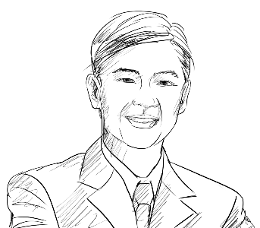




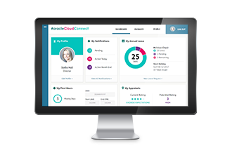





Notional Architecture
Embracing Data Variety with Oracle Cloud
Twitter as a publisher in Kafka
Revenue from Oracle Fusion ERP Finance Cloud (demo content)
Roland
CIO
Event Hub Cloud
Lisa
Marketing Executive
Big Data as a Consumer of Kafka
Interaction
Default connection between Analytics and Big Data
Oracle Analytics
Cloud Service
Oracle Big Data Cloud
Marketing budgets stored in Excel, blended in Analytics
Analytics datasets stored in Database Cloud
Database
Cloud Service
Copyright © 2018, Oracle and/or its affiliates. All Rights Reserved. | Confidential – Oracle Internal
Notes:
.

